Slide 1
User authentication using Support vector Machine classifier
On Mouse log data
Presented By
RAVI KAKAIYA (21EE64R06)
SOURABH BHATTACHARYA (21EE64R18)
RISHABH TRIPATHI (21EE64R11)
SHUBHANKAR SARKAR (21EE64R01)
ANKIT KUMAR (20MI91R03)
SANTANU KUNDU (18EC10052)
Guided by, Bijaylaxmi Das
Endorsed by , Prof. S. Mukhopadhyay

Slide 2
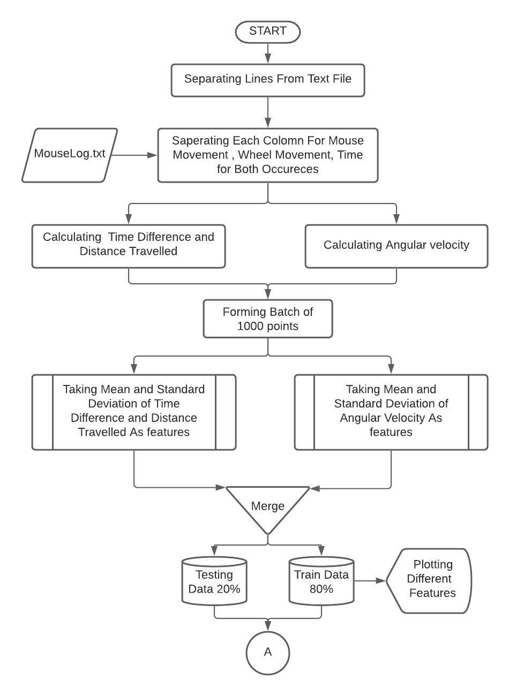
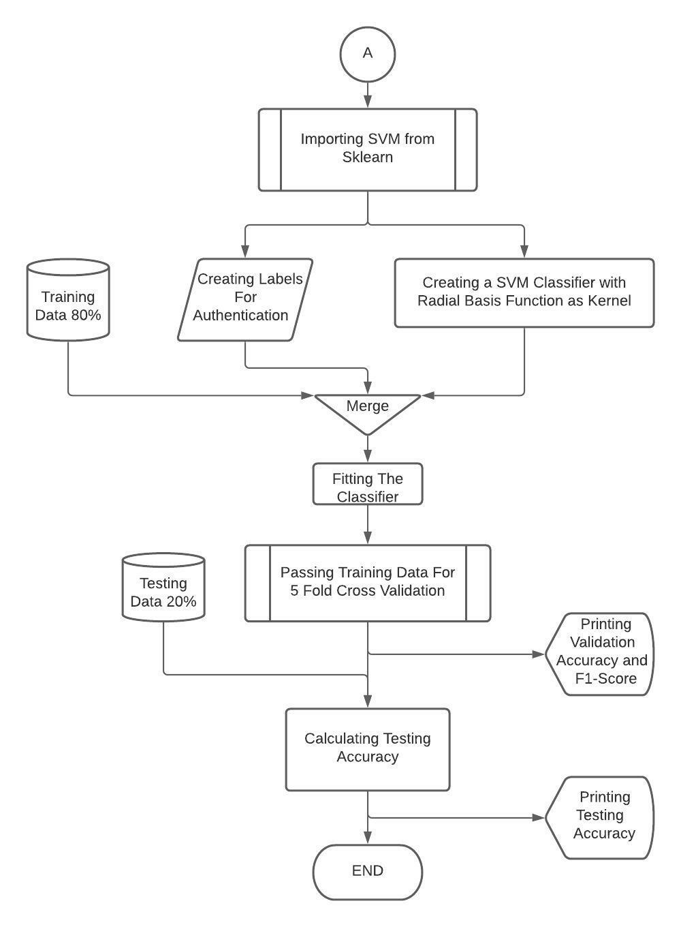
Flow chart

Slide 3
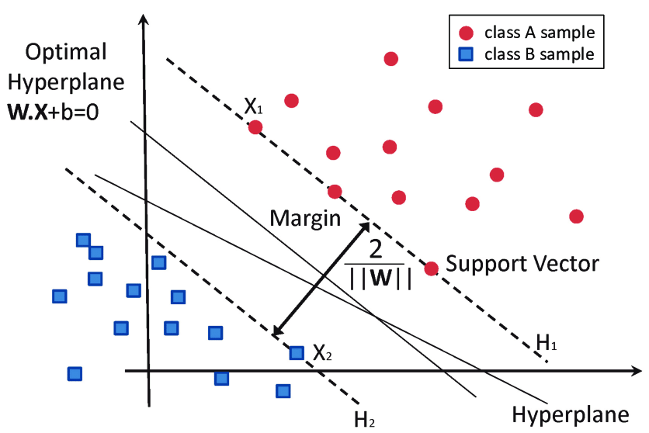
Support vector machine

Slide 4
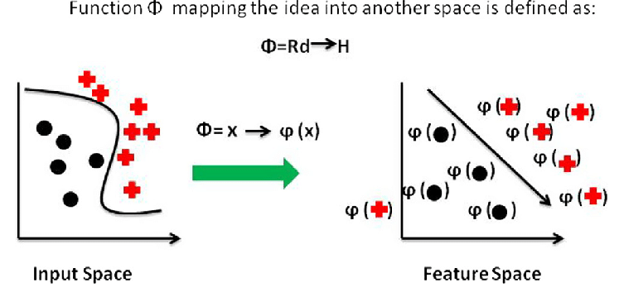
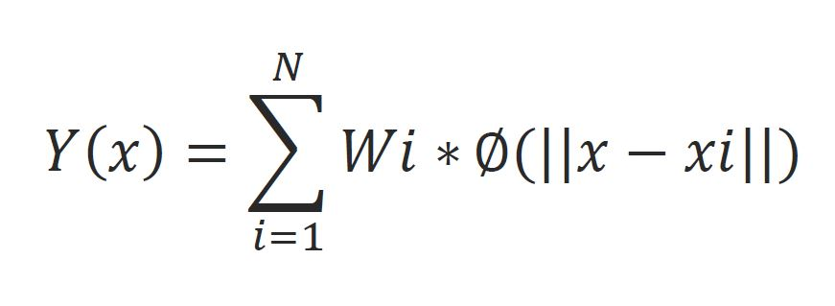
Radial basis function
It is a generalization of polynomial kernel function which maps a finite dimension input feature space into a infinite dimension feature space with assists in classification. The weights Wi are calculated by linear least square method since that is how they are related to the function. The Xi s are ‘N’ number of center points based on which given function is to be transformed.

Slide 5
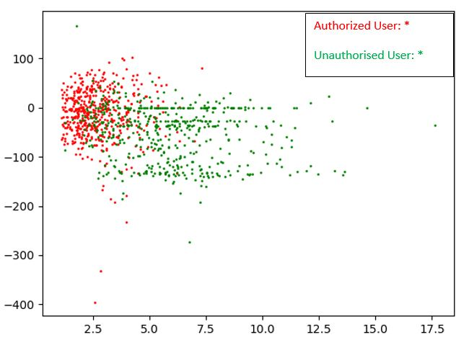
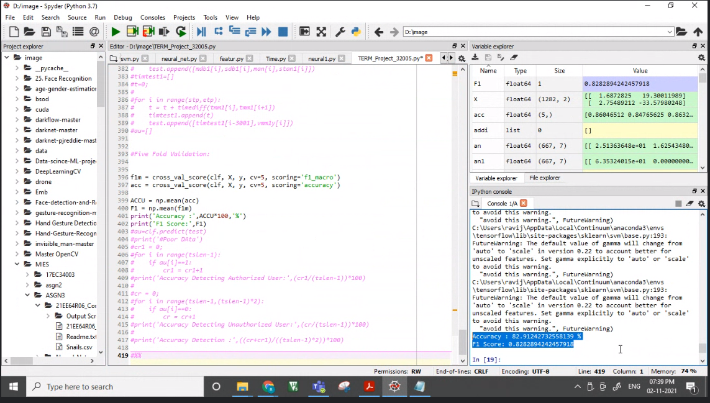
Intermediate results

Slide 6
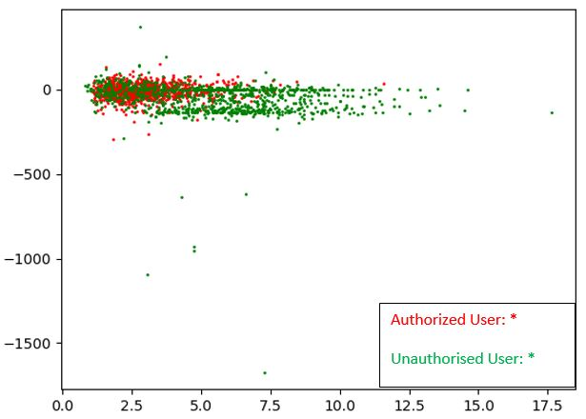
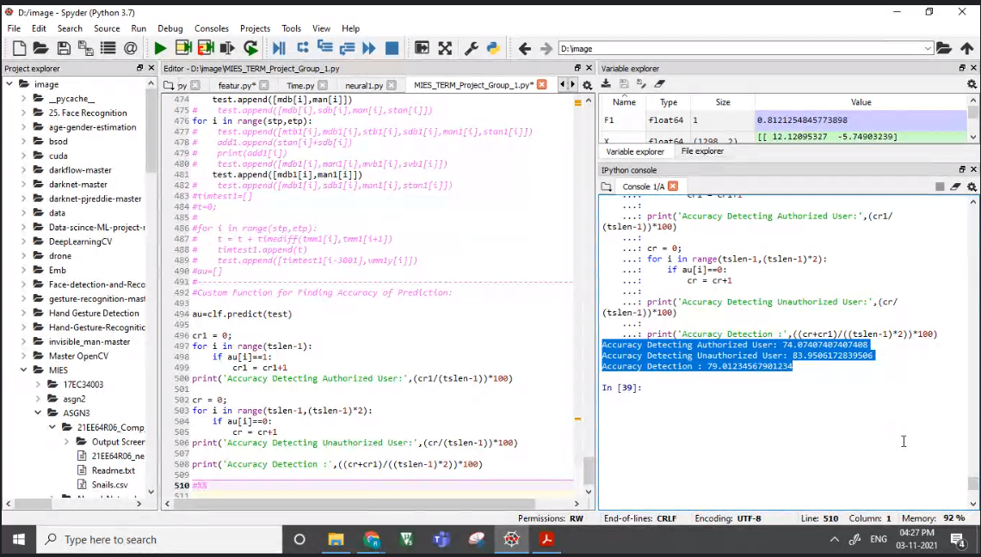
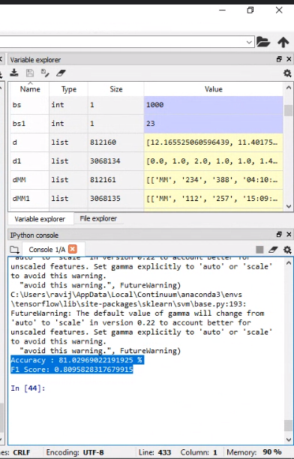
Final results

Slide 7
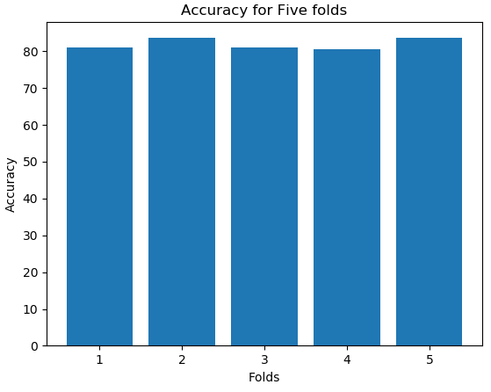
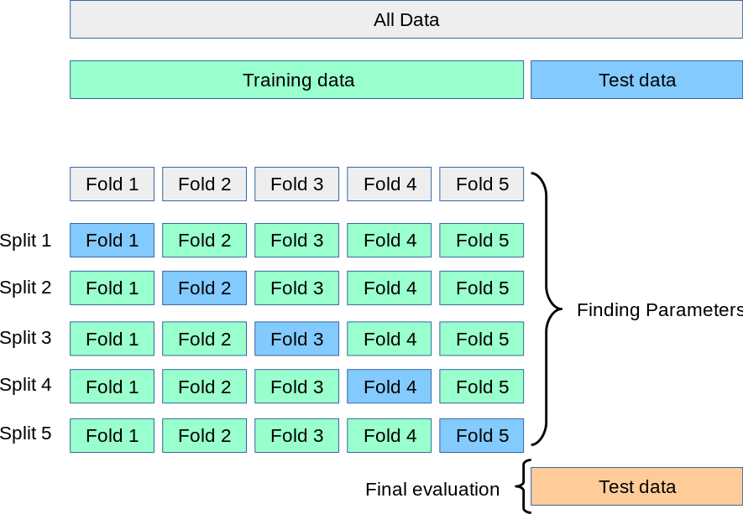
Validation accuracy

Slide 8
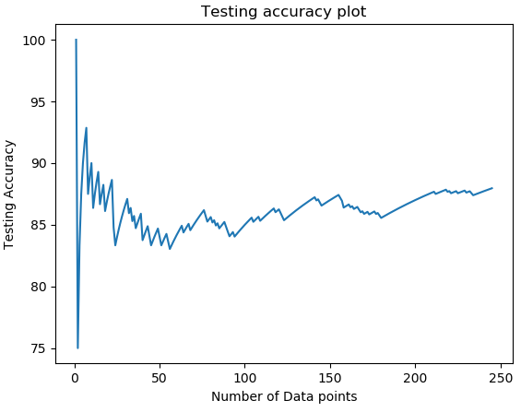
Testing accuracy

Slide 9
Conclusions
We applied One class SVM for authenticating user Based on Mouselog data.
During the entire process we were introduced to various modules as well as vivid mathematical technicalities: SVM classifier and the radial basis function among many others.
We were also exposed to the feature engineering aspects of data analysis which is worth a knowledge for future applications.

Slide 10

Thank You

